Slide 1


Classes, inheritance, file handling

Slide 2
Recap!
We should know how to…
Understand how lists, tuples, dictionaries, and sets work
Know how to do a list comprehension

Slide 3
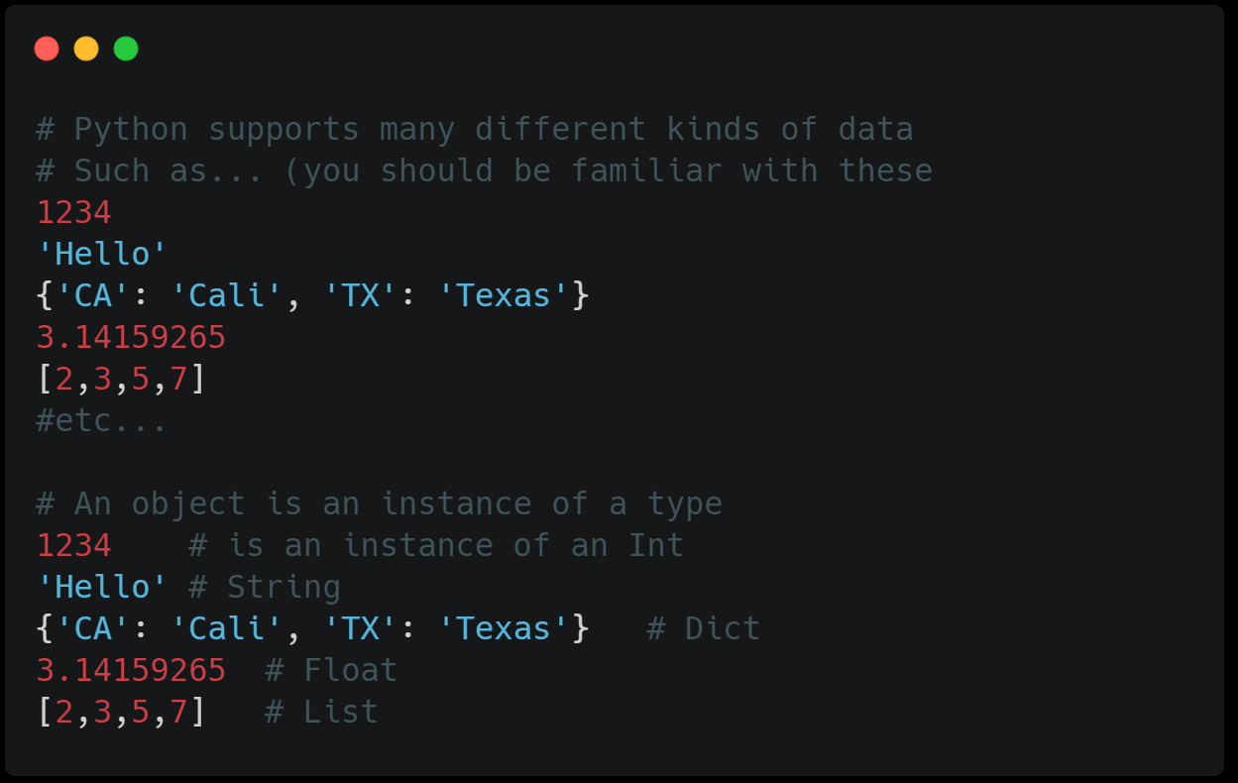
objects
Python is an object oriented programming language
So before going into classes, we have to know about objects first
Everything we seen in the previous workshops can be created as an object

Slide 4
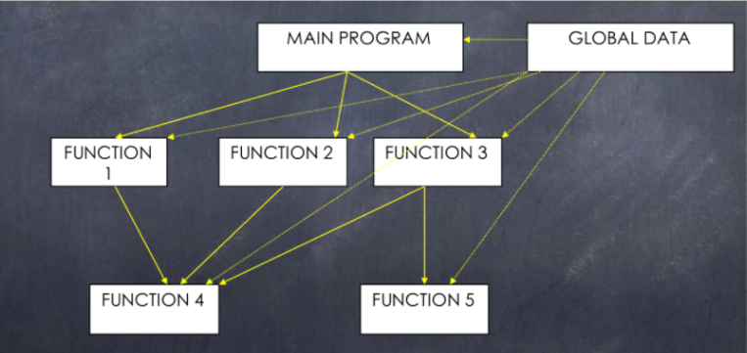
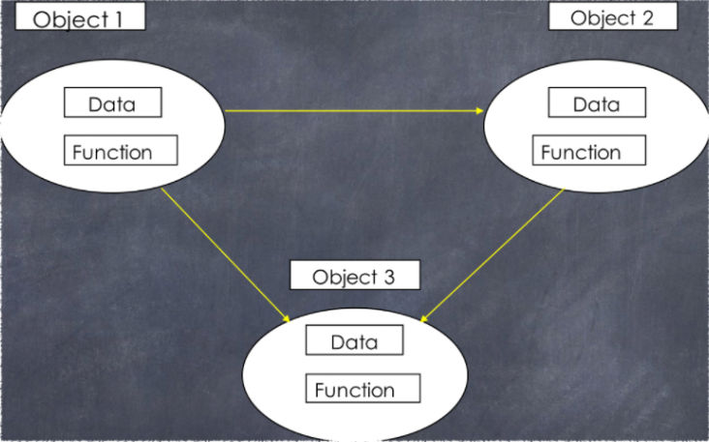
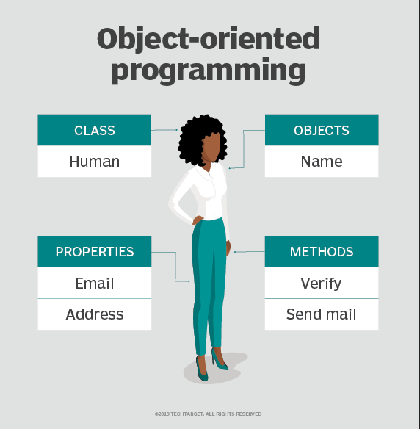
Object Oriented
Programming (OOP)
Objects have both data and methods, and a class is used to construct/ build when creating objects
Essentially, it can be described as a collection of objects that can interact
Different from structured programming (such as C)
Structured Programming
Object Oriented Programming

Slide 5
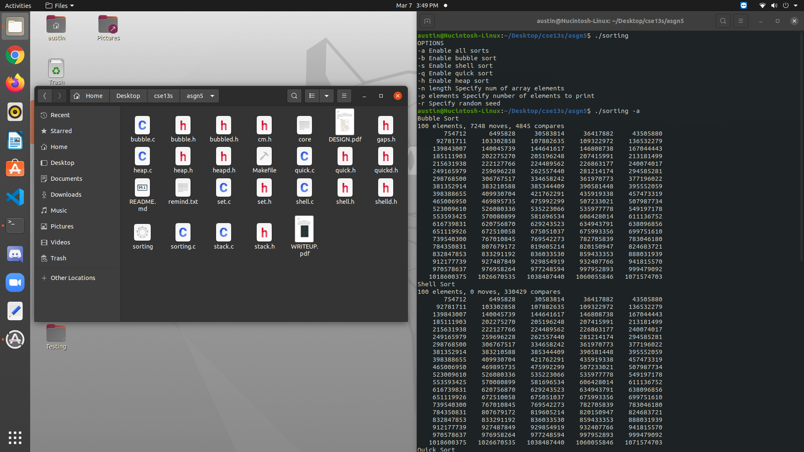
Example
Structured programming example (sorting algorithms)
Each sort function has its own file (bubble.c, heap.c …)
Runs the whole program (main function) in sorting.c
*Gitlab asgn5

Slide 6
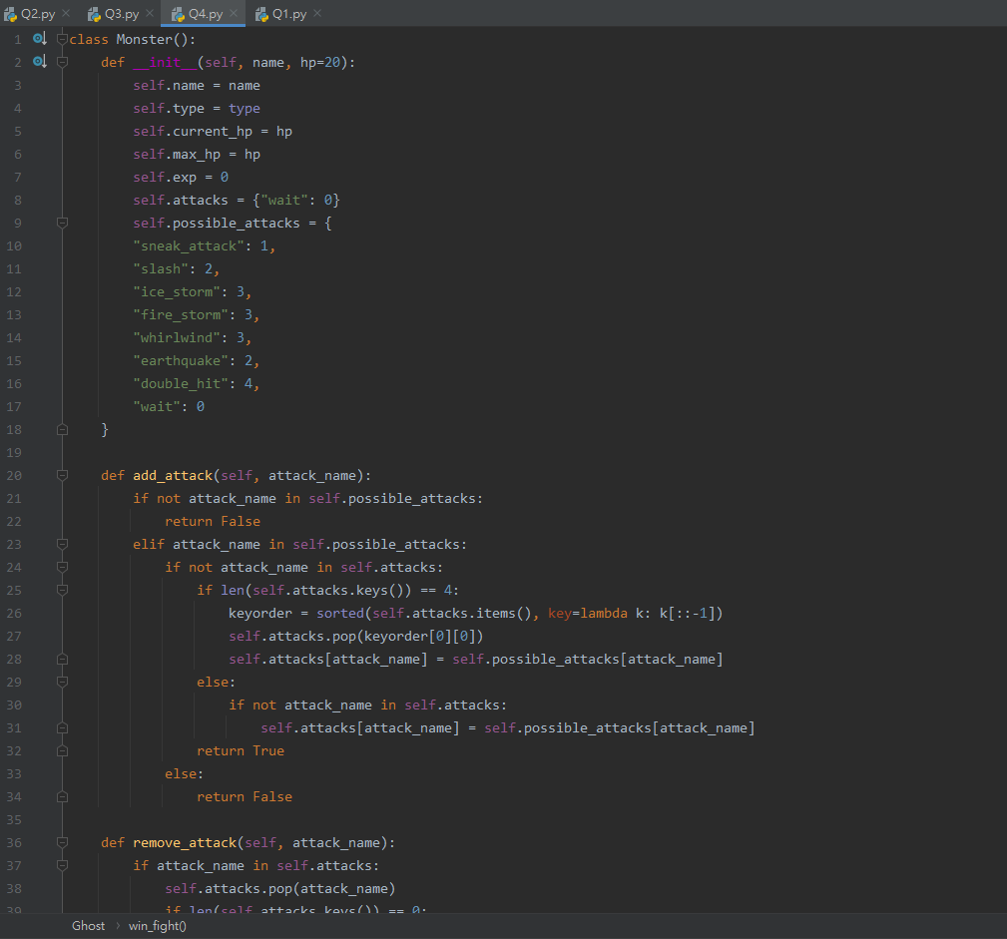
Another example
Object oriented programming example (creating monsters)
Contains a class that defines the stats of a monster (hp, abilities, damage …)
Able to fight another monster (interact with monsters created)
*CSE20 asgn 4

Slide 7
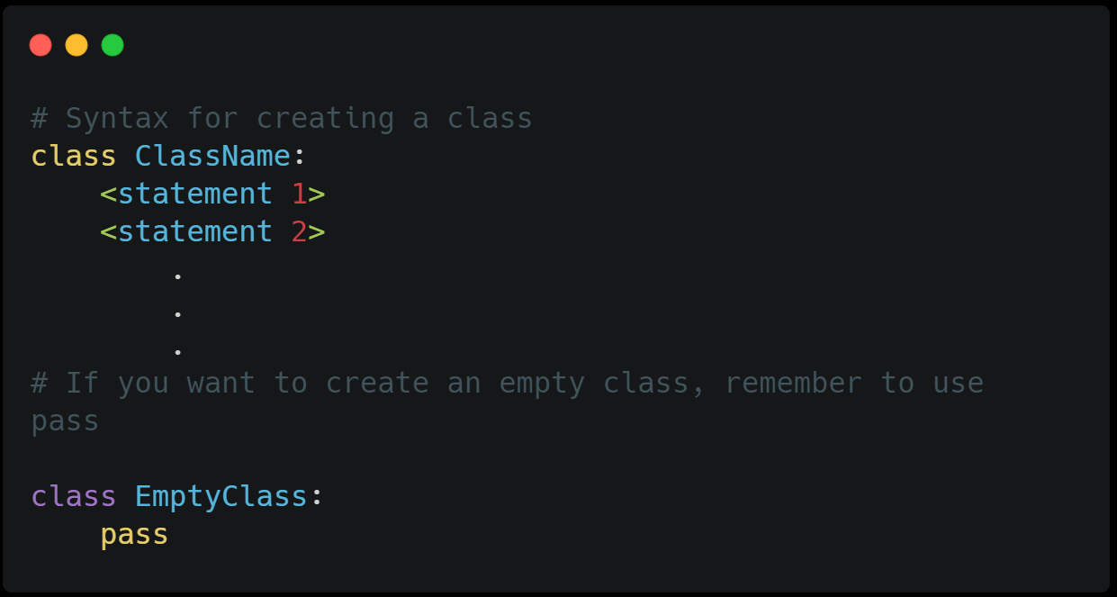
class
Now we know how objects works, lets construct them in a class

Slide 8
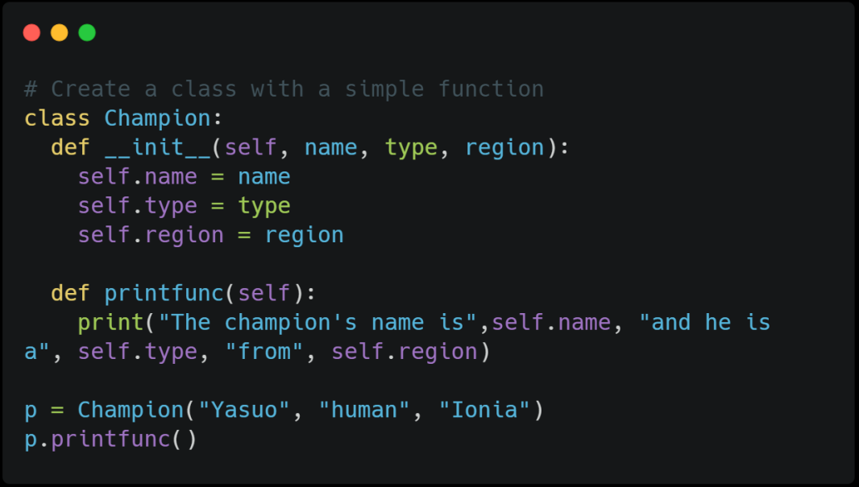
__init__()
Constructor function
Functions that are in classes are called methods
The method __init__ allows us to assign values to object properties when creating
Always executed when the class is being initiated
The argument self is used to reference the current instance of the class, and used to access variables that belong to the class (can name it to anything)

Slide 9
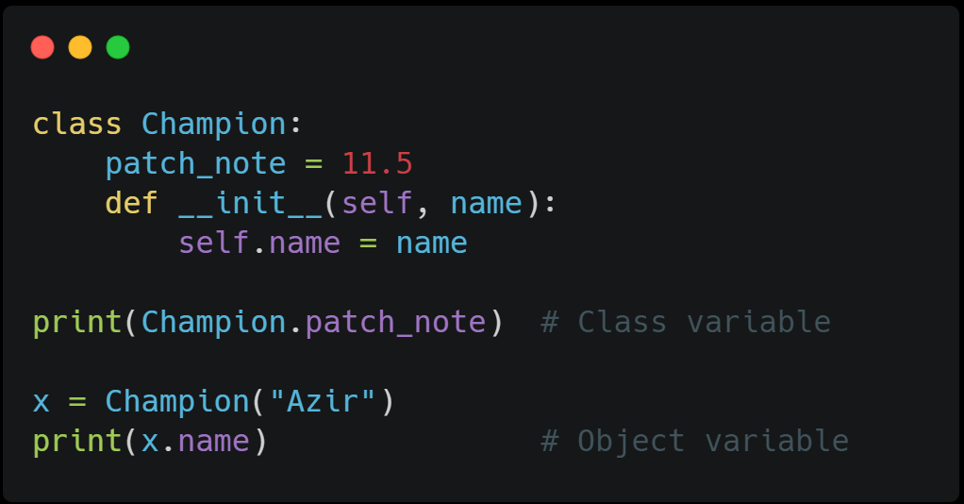
Object vs class variables
Object variable: The variables defined in the constructor that are unique to an object
Class variable: The variables that can be shared by all objects

Slide 10
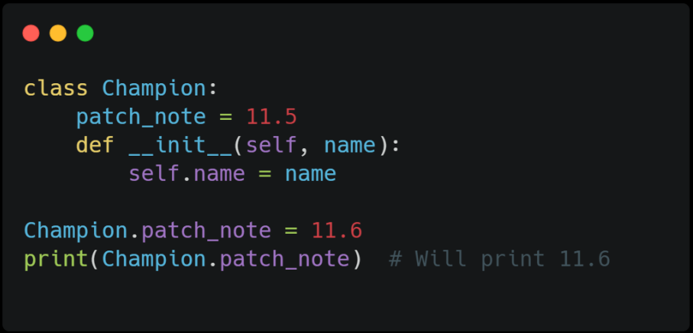
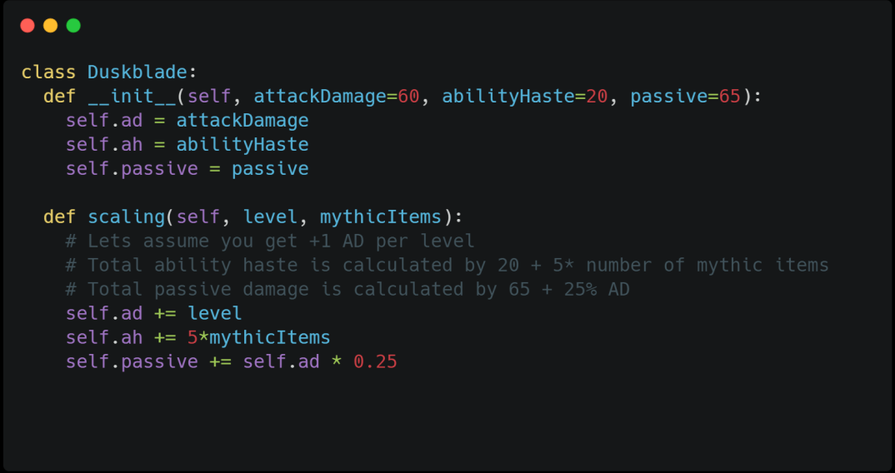
Mutability and
Modifier methods
Python objects are mutable
Can be modified using modifier methods

Slide 11
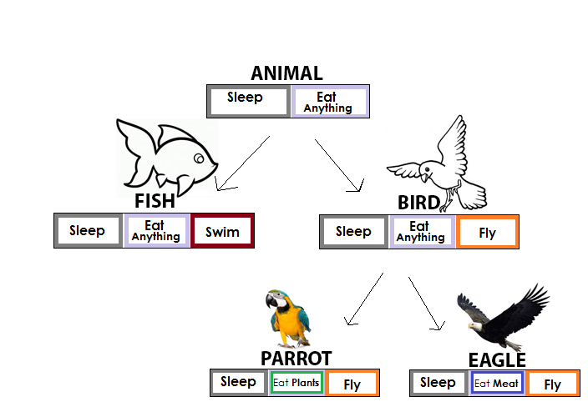
inheritance
Inheritance allows us to define a class that uses things from other classes
Parent class is the class being inherited from
Child class are classes that inherits from other classes
The child’s __init__ function overrides the inheritance of the parent’s __init__function (view notebook for examples)

Slide 12
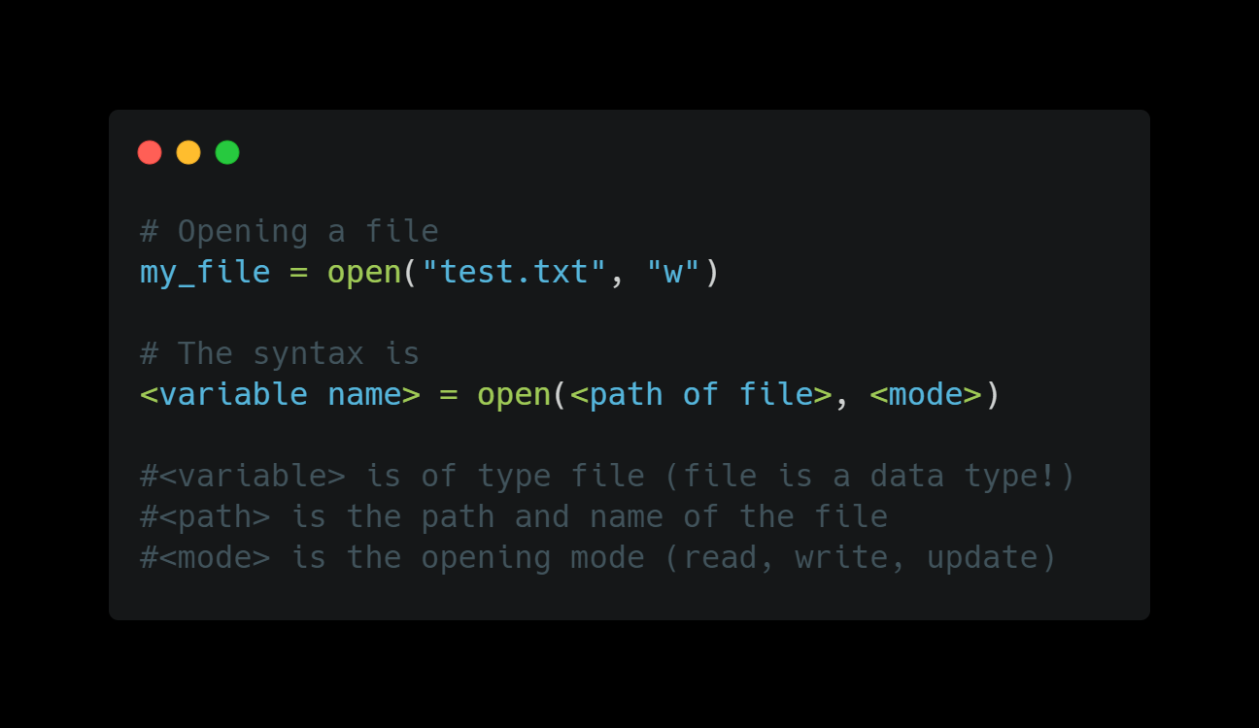
Opening/ closing
Files (file handling)
File handling is used when you need to access other files outside of the program
Must close the file after using to flush data

Slide 13
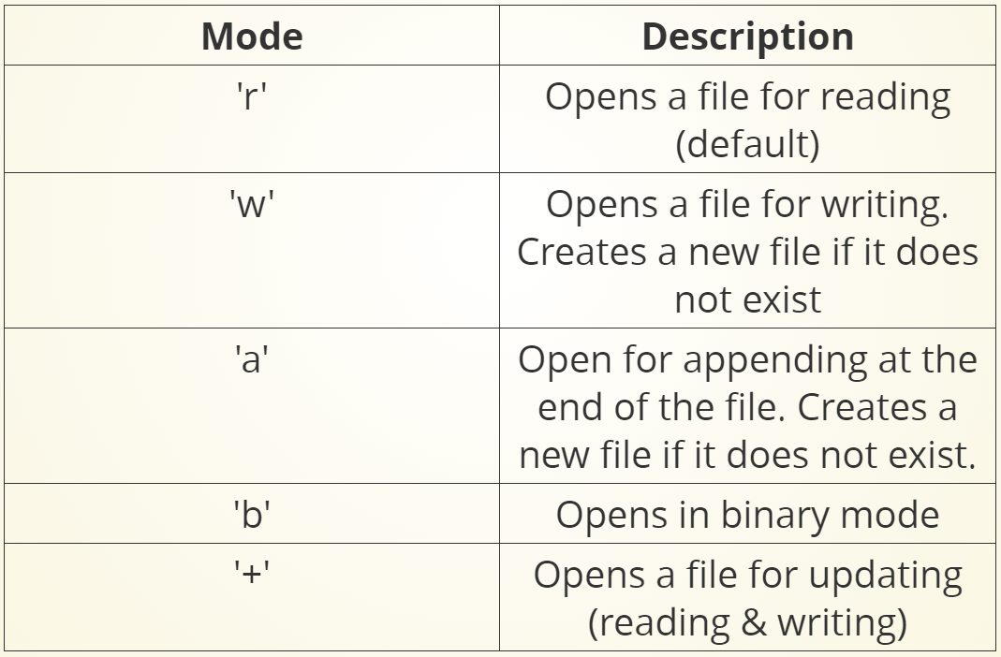
Different modes
File handling is used when you need to access other files outside of the program
Must close the file after using to flush data

Slide 14
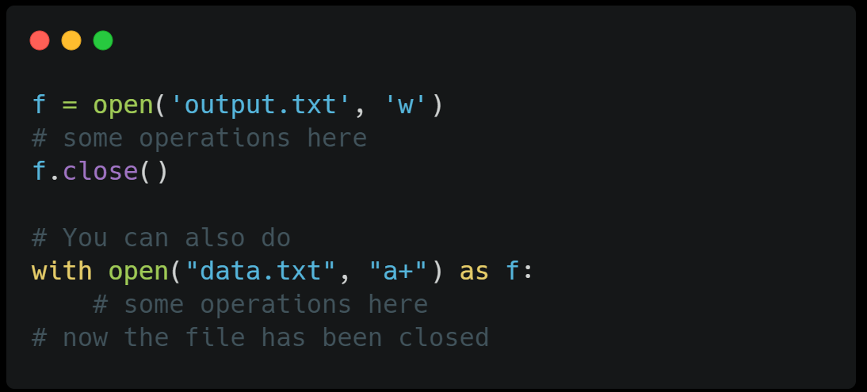
Closing a file
When we are done using the file, we have to close it
The close method is how you would close it
Its good practice to close it because if you don’t, it will affect performance and not all programming languages has “garbage collectors”

Slide 15
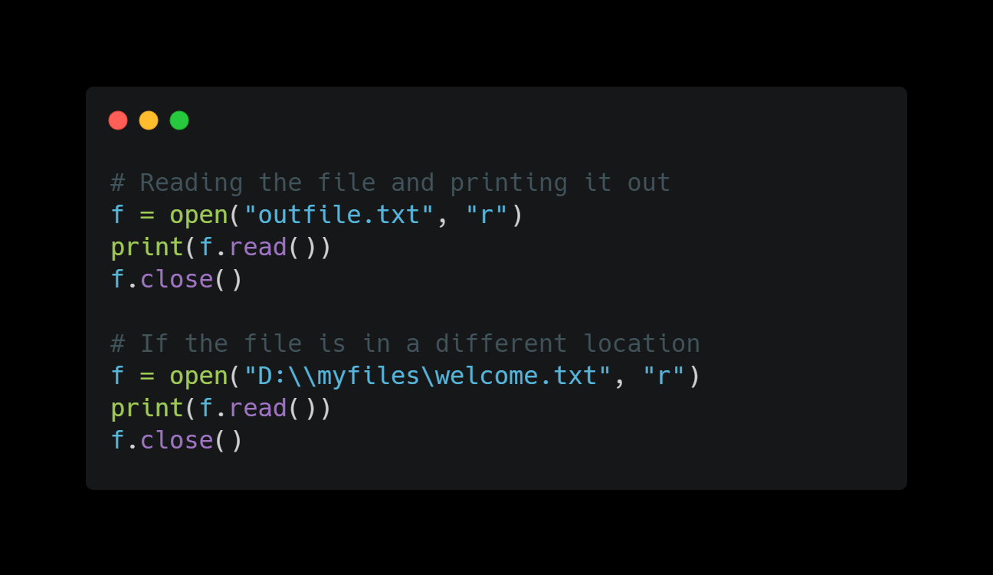
reading a file
When a file is opened, a pointer is placed at the beginning of the file. After reading,
You can use the read() function to read the file

Slide 16
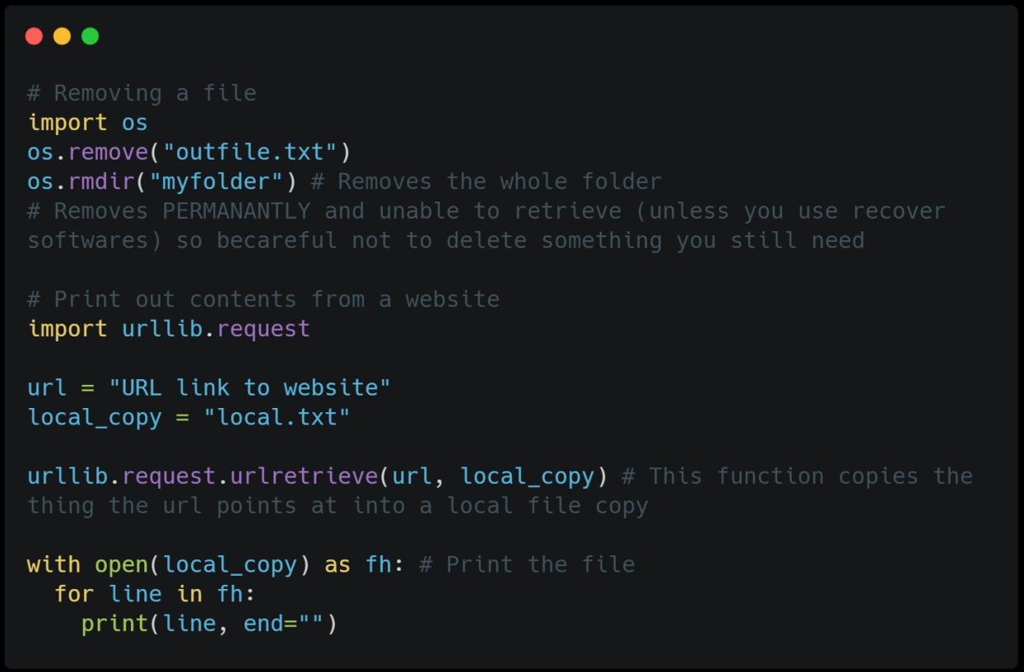
removing a file
To remove a file, you would have to import the os module
We will talk more about modules in the next workshop
You can also import urllib.request to take data from a url

Slide 17
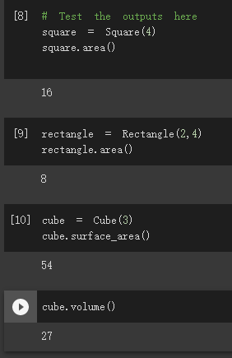
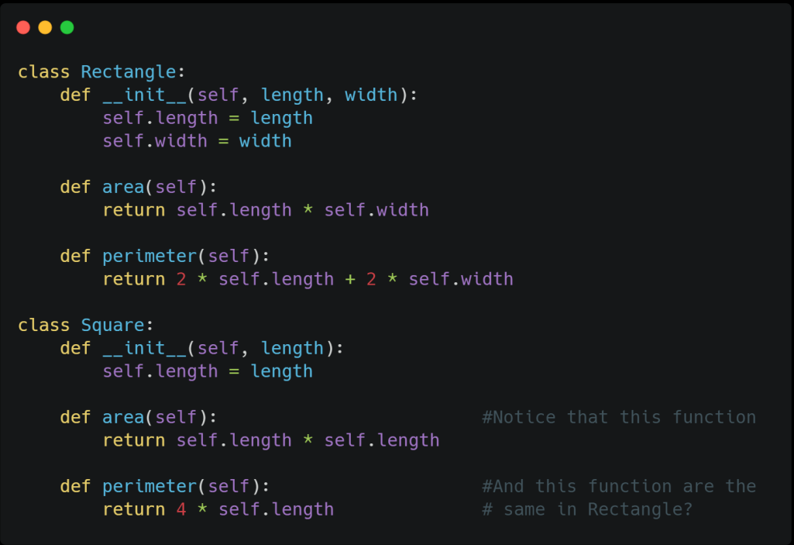
Challenge!!
Complete classes and functions below. The Square class should inherit the Rectangle class and the Cube class inherits from the Square class
Hint: The Rectangle and Square class can be written as such. Try to simplify Square by inheriting things from Rectangle.

Slide 18
Thanks!!
Email: ayyen@ucsc.edu

